Slide 1











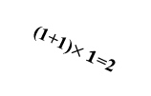





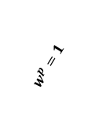









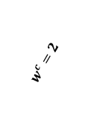









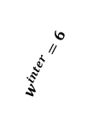





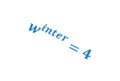

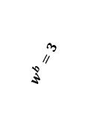


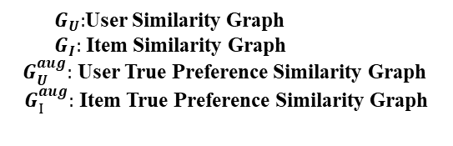

$G_{R}^{p}:Graph p$ $G_{R}^{c}:Graph c G_{R}^{b}:Graph b G_{R}^{p,de}:denoised Graph p$ $G_{R}^{c,de}:denoised Graph c$ $G_{R}^{b,de}:denoised Graph b$
p:page view c:cart b:purchase
$$p<_{beh}c<_{beh}b$$
$$w^{p}=1<w^{c}=2<w^{b}=3$$
Intra-Behavior Weighting
Weight Fusion and Denoising
$$G_{R}^{p}$$
$$G_{R}^{p}$$
$$G_{R}^{p,de}$$
$e_{u}:$User Embedding
2
2
1
$$⊕$$
5
3
Weighted Denoising GNN
$e_{i}:$Item Embedding
$$w^{p}=1$$
1
2
1
1
1
6+1=7
1+4=5
Prediction
6
5
5
1+6=7
$e_{p}:$p Behavior Embedding
$e_{c}:$ c Behavior Embedding
$$G_{R}^{c}$$
$$G_{R}^{c}$$
$$G_{R}^{c,de}$$
$e_{b}:$ b Behavior Embedding
(1+0) $×1$
1
$$⊕$$
5
Preference-informed Inter-Behavior SSL
$$w^{c}=2$$
1
2
6+1=7
6
(1+1)$×1$=2
2+4=6
1+6=7
$$𝓛_{inter_ssl}$$
$$G_{R}^{b}$$
$$G_{R}^{b}$$
$$G_{R}^{b,de}$$
$$w^{b}=3$$
1
1
1
1
$$⊕$$
1+6=7
5
5
$$G_{R}^{b}$$
$$G_{R}^{aug}$$
1
1+4=5
1+6=7
$$w_{ui}^{intra,k}=\left(1+\text{Co}\text{−}\text{Intereaction}\right)×R_{ui}^{k}$$
$$w_{ui}^{com,k}={αw}_{ui}^{intra,k}+(1−α)w_{ui}^{inter}$$
Preference-informed Intra-Behavior SSL
$$G_{U}$$
Inter-Behavior Weighting
$$G_{U}^{aug}$$
1
Pull
Pull
$$G_{I}$$
$$3$$
$$w^{inter}=4$$
$$w^{inter}=6$$
4
4
$$w^{inter}=6$$
$$G_{I}^{aug}$$
$$4$$
Push
Push
$$w_{ui}^{inter}=w^{p}{×R}_{ui}^{p}+w^{c}{×R}_{ui}^{c}+w^{b}{×R}_{ui}^{b}$$
$$G_{U}^{aug}$$
$$𝓛_{inra_ssl}$$
$$G_{I}^{aug}$$
${ G}_{U}:$User Similarity Graph
${ G}_{I}:$ Item Similarity Graph
$G_{U}^{aug}:$ User True Preference Similarity Graph
$G_{I}^{aug}:$ Item True Preference Similarity Graph
Inter- and Intra-Behavior Weighted Denoising Module
Preference-informed Inter- and Intra-Behavior Representation Enhancement Module
Notes:
TODO 行为内加权

Slide 2

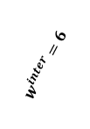



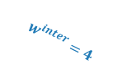

















Intra-Behavior Weighting
Weight Fusion and Denoising
$$G_{R}^{b}$$
$$G_{R}^{b}$$
$$G_{R}^{b,de}$$
2
2
1
$$G_{R}^{c}$$
2
2
$$G_{R}^{c}$$
2
2
1
$$G_{R}^{c,de}$$
1
2
1
1
$$G_{R}^{p}$$
1
1
2
1
1
1
$$G_{R}^{p}$$
1
1
2
1
1
$$G_{R}^{p,de}$$
1
1
2
2
1
1
1
1
2
2
1
1
$$⊕$$
1
2
2
1
1
1
1
2
2
1
2
2
1
1
2
2
1
2
1
1
1
1
1
2
1
1
1
1
2
1
1
1
1
2
2
1
2
$$⊕$$
Inter-Behavior Weighting
$$G_{U}$$
$$G_{U}^{aug}$$
Prediction
1
$$w^{inter}=4$$
$$w^{inter}=6$$
$$3$$
4
4
$$w^{inter}=6$$
$$G_{I}$$
$$4$$
$$G_{I}^{aug}$$
Preference-informed Intra-Behavior SSL
Preference-informed Inter-Behavior SSL
Weighted Denoising GNN
Pull
Pull
$$𝓛_{inter_ssl}$$
$e_{u}:$User Embedding
$e_{i}:$Item Embedding
Push
Push
$$G_{R}^{b}$$
$$G_{R}^{aug}$$
$e_{p}:$p Behavior Embedding
$$G_{U}^{aug}$$
$$𝓛_{inra_ssl}$$
$$G_{I}^{aug}$$
$e_{c}:$ c Behavior Embedding
$e_{b}:$ b Behavior Embedding

